Slide 1
AT – Curative or Preventative ACGM 2016 Minneapolis
Presented by
Niall Kelly, MSc(Mgnt), Alexander Technique Teacher
10th June 2016

Slide 2
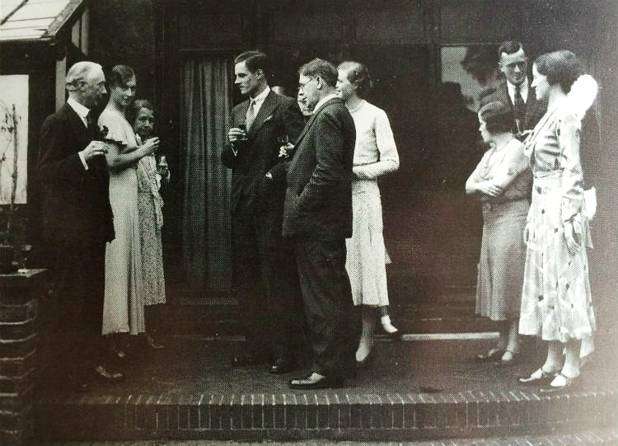
Alexander’s world 1930’s
House near Buckingham Palace. A doorman. Teachers and staff Dinners and theatre. Horse and stables. Ordered a Rolls Royce. House in the country

Slide 3
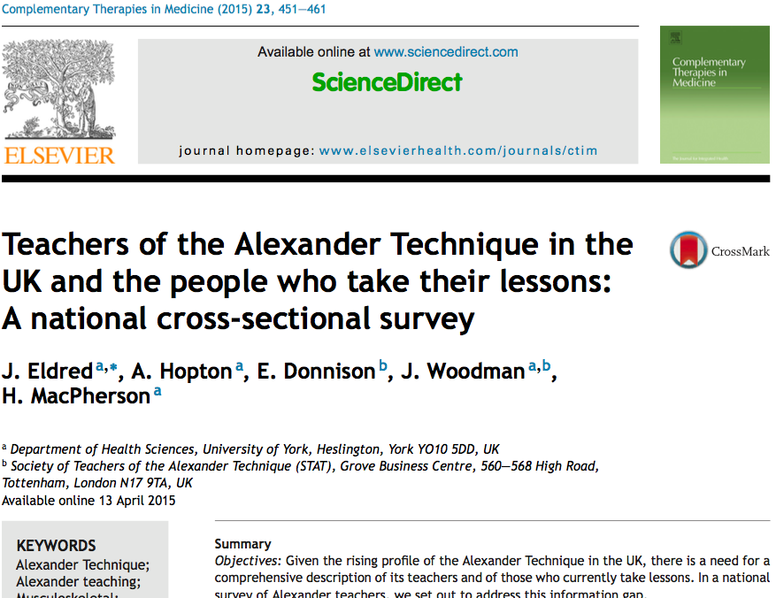
University of York 2015
Survey of 534 teachers in ATI ITM STAT
Average age 58
50% in non AT work

Slide 4
Interest in Alexander Technique 2004 to 2016

Slide 5
Keep calm
and keep
putting
hands on

Slide 6
Or we can ask Questions
Is AT today = AT of FMA
Curative or preventative
What medical support for AT
Some options to explore

Slide 7
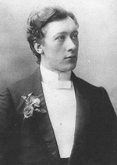
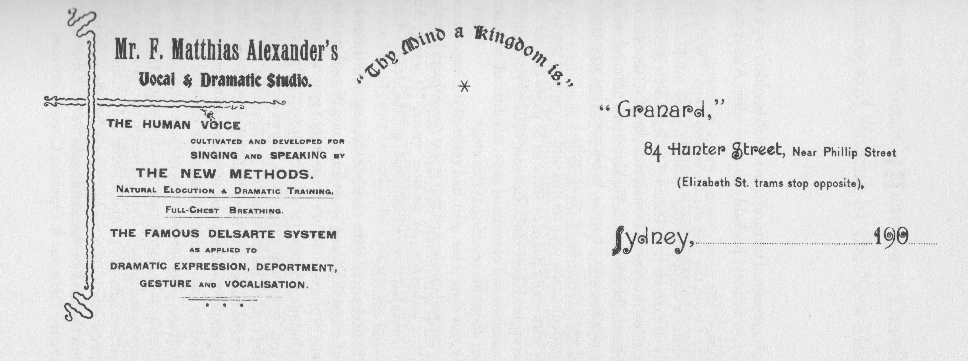
Is Alexander Technique of today
Alexander’s Techniques of 1900?
Natural Elocution. Full Chest Breathing. New way of Physical Development (standing). Delsarte System

Slide 9
What has he got?
New way of standing
New way of breathing
New way of moving
New way of thinking
Constructive Conscious Control

Slide 10
“Why then, if you talk about a preventative strategy do you work in a curative fashion? FM Alexander. CCCI p78

Slide 11
What does it do?
Everything ranging from A – T
Angina - GBS and Drs MacKenzie and Murdoch

Slide 12
1996 Rene Cailliet Forward Head Posture
Up to 30% reduction in lung capacity
Pressure on heart and surrounding blood vessels
Impaired digestion – reduction in peristalsis
Sensitivity to pain
Back, neck and shoulder pain

Slide 13
Hyperkyphotic needing 1.7cm pad
44% greater risk of death from
atherosclerosis

Slide 14
2006 British Regional Heart Study
3cm loss of height 42% greater risk
of death from
CVD

Slide 15
Danger of a Sedentary Lifestyle
Greater screen time 50% increased risk of death and 25% risk from
Angina & heart attack
25 Sept 2014

Slide 16
Effects of Poor Posture and Breath
FM Alexander
Rene Cailliet
Heart and
other disease
US Jrnl Geriatrics society
British Regional Heart Study
Dr Levine Mayo Clinic
40 – 50%
Increased risk
Of death from CVD

Slide 17
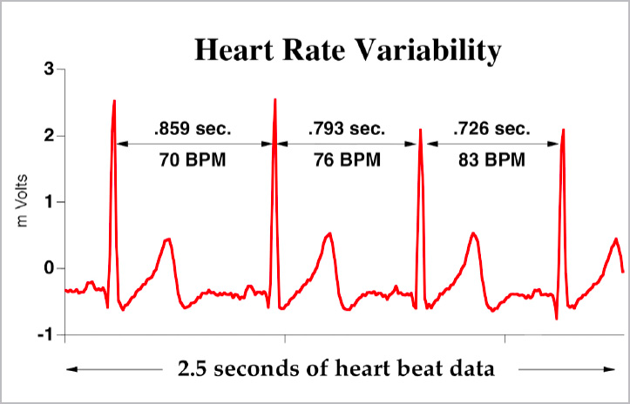
HEART RATE VARIABILITY
See YouTube Dr Richard Gervirtz PhD

Slide 18
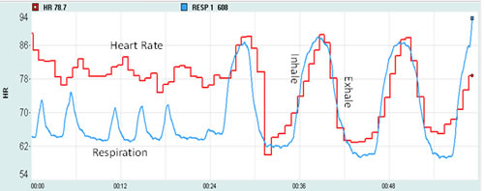
Heart Rate and Breath
94
86
78
70
62
54
Heart Rate
Inhale
Exhale
Respiration
00:00 00:12 00:24 00:36 00:48 00:60
Whispered Ahh?

Slide 19
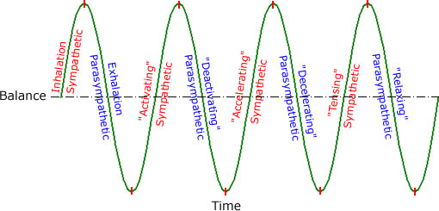
Neurological States from www.Coherence.com
PARASYMPATHETIC
SYMPATHETIC

Slide 20
Constructive Conscious Control and Hands-On
We restore natural functioning,
i.e., predominantly parasympathetic state,
through natural alignment and natural breathing

Slide 21
Commission Research

Slide 22
Two stars to hitch our wagons to
Stress
Sitting as the new smoking
As a mindfulness or presencing approach to living

Slide 23
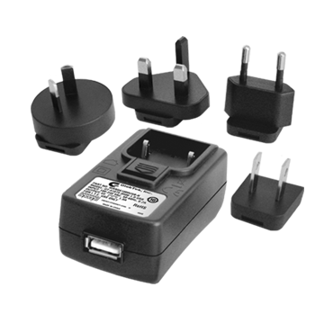
47% of First Movers FAIL
92% of Second Adaptors SUCCEED

Slide 24
Alexander Technique

Slide 25
Alexander Technique & Yoga

Slide 26
AT & Mindfulness

Slide 27
Yoga and mindfulness emphasise mind focus We emphasise body focus!

Slide 28
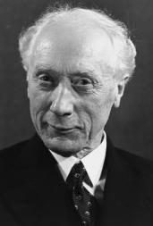
“My Technique is based on the inhibition of undesirable, unwanted responses to stimuli and hence it is primarily a technique for the development of the control of human reaction”

Slide 29
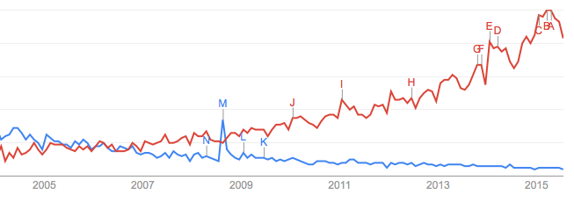
Mind and Body Fields
Is it
time
we stepped into
the mindfield!

Slide 30
Thank You

Slide 33
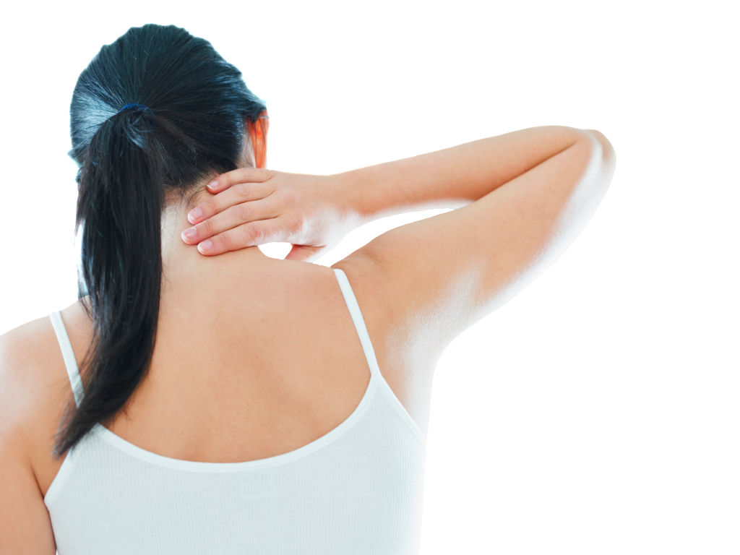
2
3
Nearly began lessons for musculoskeletal conditions, including back symptoms, posture, neck pain, and shoulder pain

Slide 35
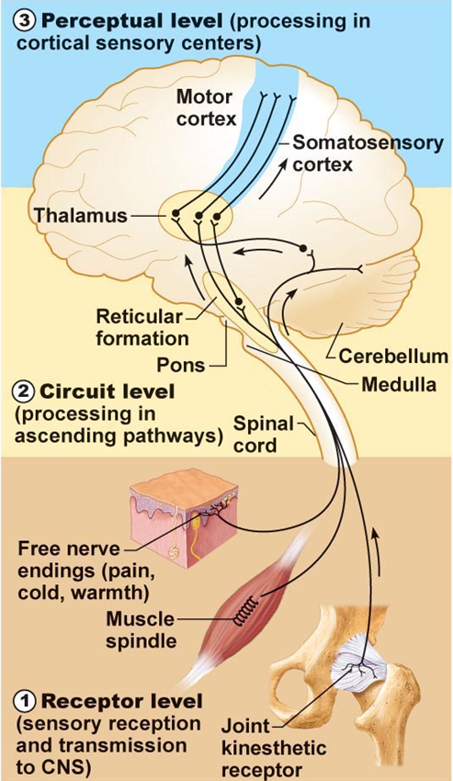

Slide 36
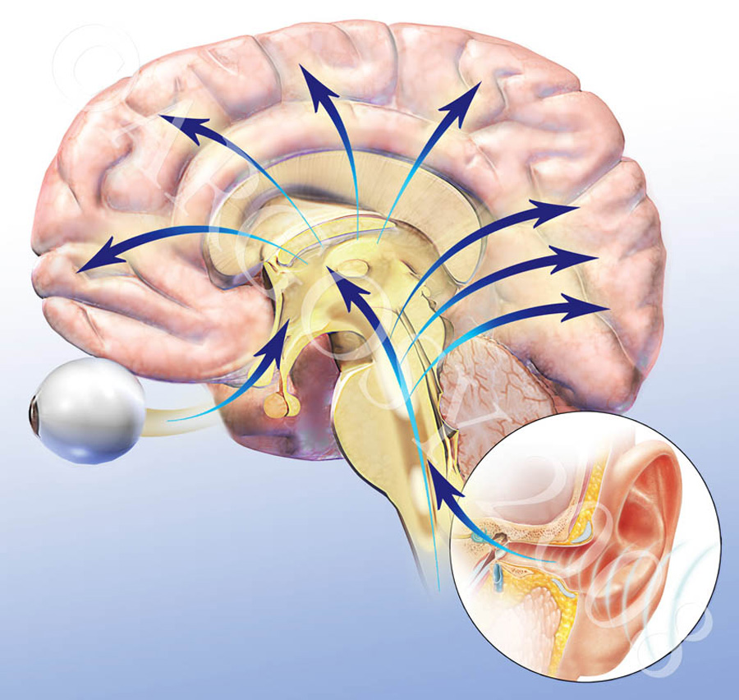

Slide 37
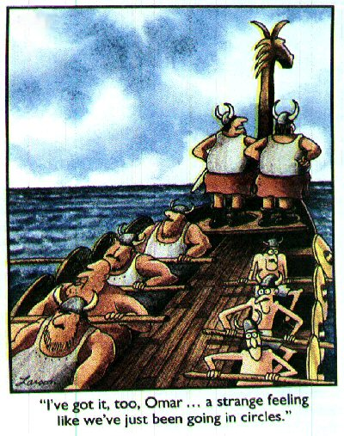
“I’ve got it,
too Omar…
a strange
feeling
like we’ve
just been
going in
circles.”

Slide 38
https://www.youtube.com/watch?v=M_n6l7g9Nvo

Slide 39
What have we got?
1998 Rene Cailliet effect on heart and vessels
2004 Geriatrics Hyper-Kyphosis: 1.44% atherosclerosis
2006 British Heart - 3cms loss in height: 1.42% cvd
Dr James Lavine Mayo Clinic – sitting is new smoking
Impaired functioning from loss of natural alignment and natural breathing

Slide 40
Those with greater screen time had:
A nearly 50% percent increased risk of death from any cause
About a 125% percent increased risk of events associated with cardiovascular disease, such as chest pain (angina) or heart attack
James Lavine Mayo Clinic 25 Sept 2014

Slide 41
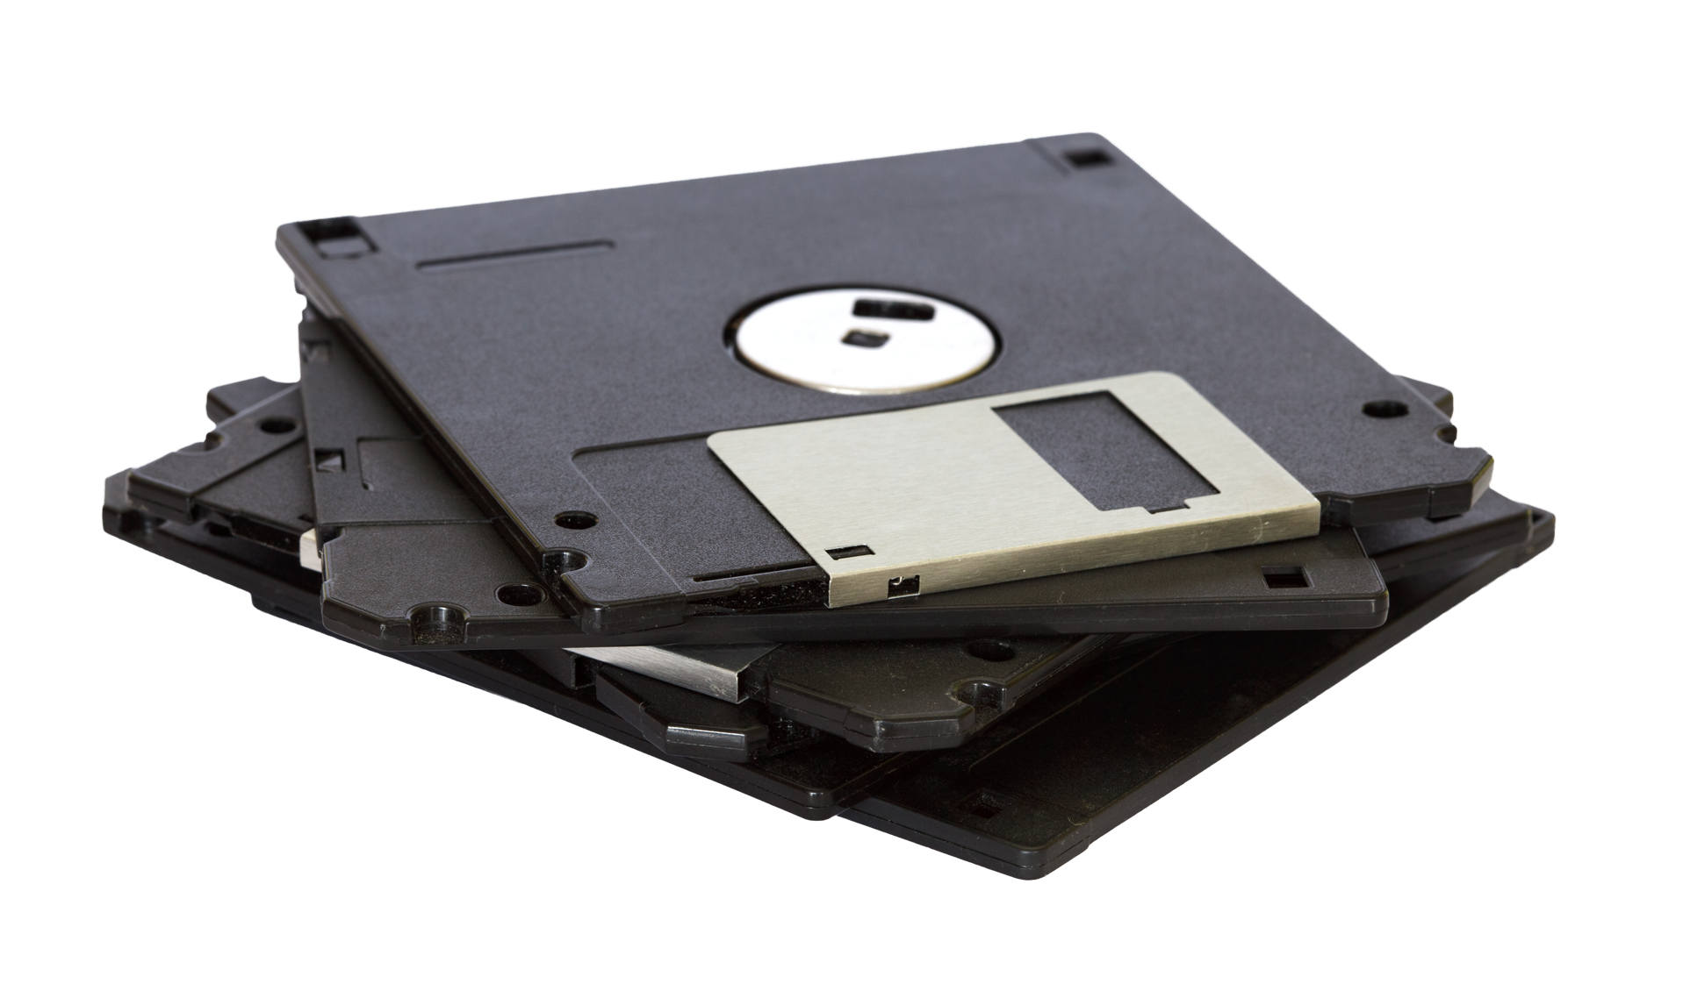
47% First Movers fail
92% Fast Followers thrive

